Slide 1
My Digital Skills Journey
Juan Dela Cruz · Demo deck

Slide 2
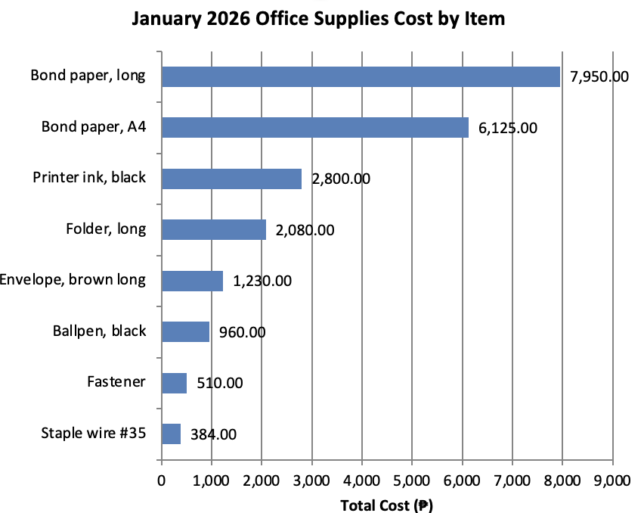
Office Supplies Inventory

